Slide 1




BeneFIX – Haemophilia
Monthly European IMS
July 2012
Alessandra Patella
Haemophilia ESAT Team

Slide 2















Click on symbol to jump to
Specific section and
Back to Summary
Summary
Market Coverage
  IMS Channel Coverage
Haemophilia Franchise Performance
  Value Performance Overview
BeneFIX Market Performance
  BeneFIX Market MAT Sales Performance per Country
  BeneFIX Market MAT Trends
BeneFIX Performance
  BeneFIX MAT Sales Performance
  BeneFIX Trends and Shares
  BeneFIX Historic Sales per Region
Country Performances
  Benefix Market Sales in individual Countries

Slide 3
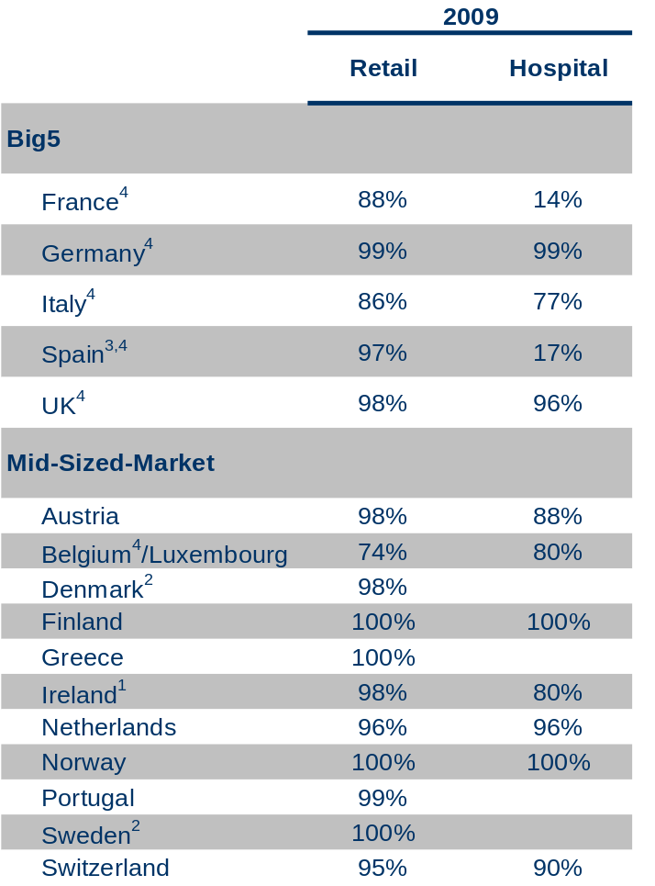
IMS Channel Coverage
IMS Channel Coverage
1) Coverage varies depending on ATC, 2) Combined Retail/Hospital panels, 3) 17 % of hospitals, 27% of hospital beds, 4) Consumption panels
Source: IMS MIDAS (data shown is not report specific)

Slide 4
Haemophilia Franchise Performance

Slide 5
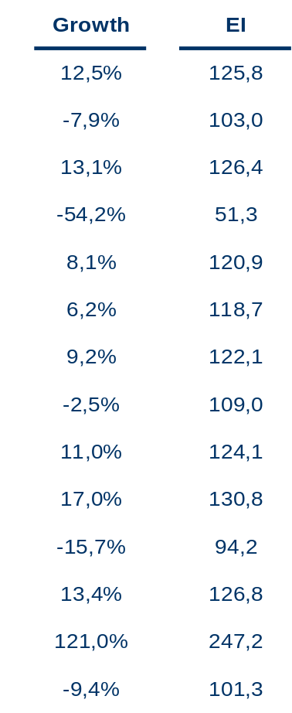
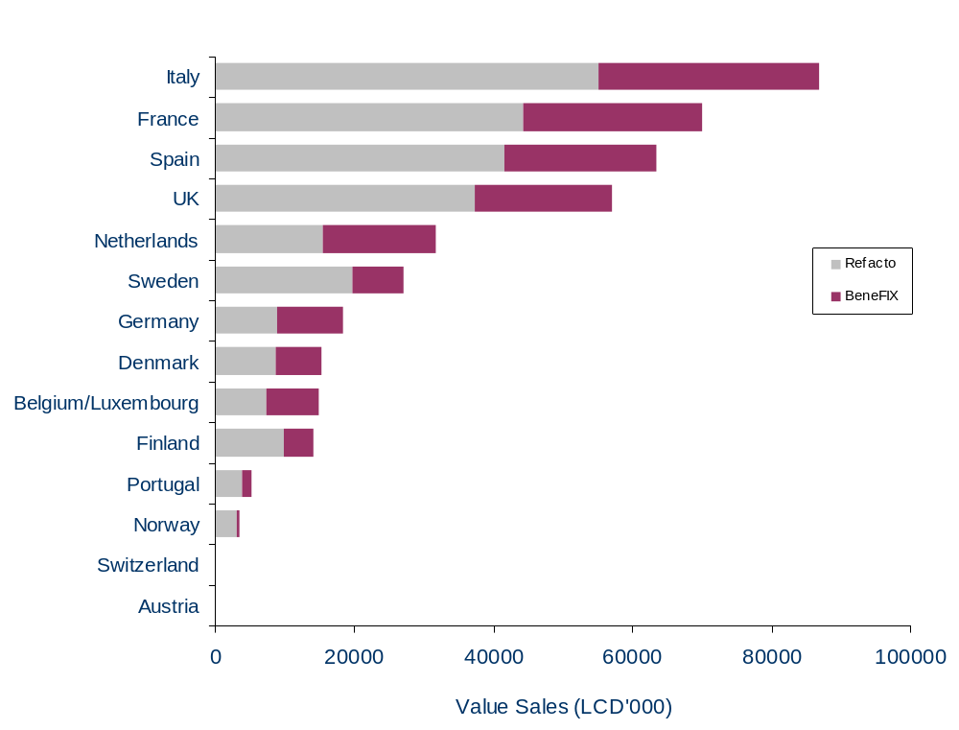
Haemophilia Franchise MAT Value Sales Performance
per Country
EI is calculated vs. the Europe 16 Haemophilia Market, Growth and EI are for total Haemophilia Franchise
Source: IMS MIDAS Data, MAT 07/2012

Slide 6
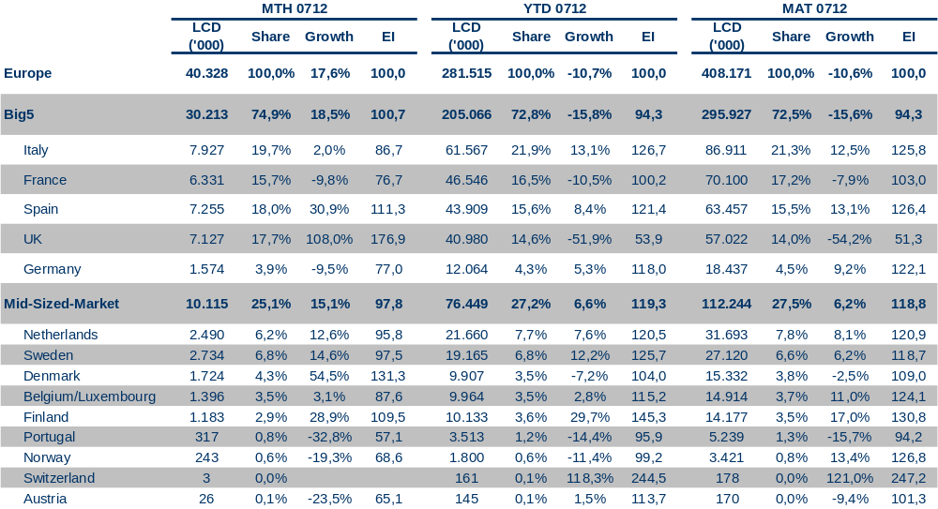
Haemophilia Franchise
Value Performance Overview
Share and EI is calculated vs. the Europe 16 Haemophilia market
Source: IMS MIDAS Data, MAT 07/2012

Slide 7
BeneFIX Market Performance

Slide 8
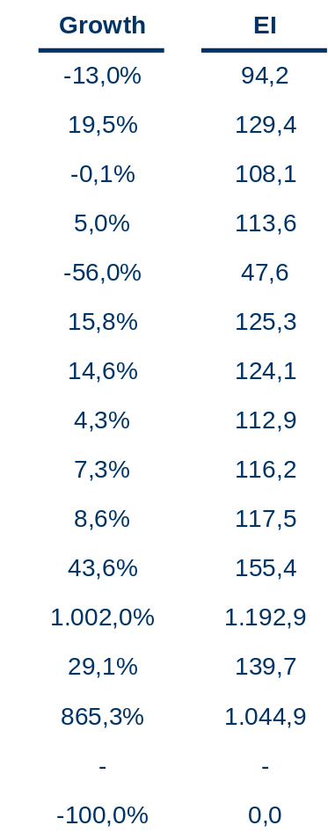
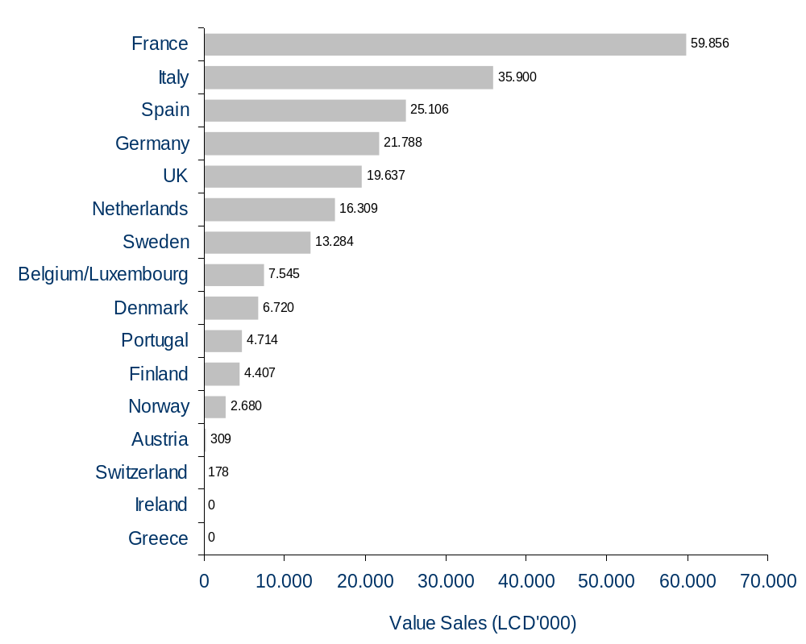
BeneFIX Market MAT Value Sales Performance
per Country
EI is calculated vs. the Europe 16 BeneFIX Market
Source: IMS MIDAS Data, MAT 07/2012

Slide 9
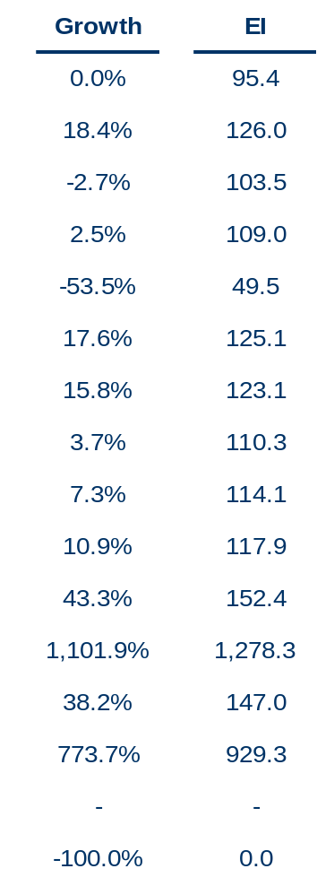
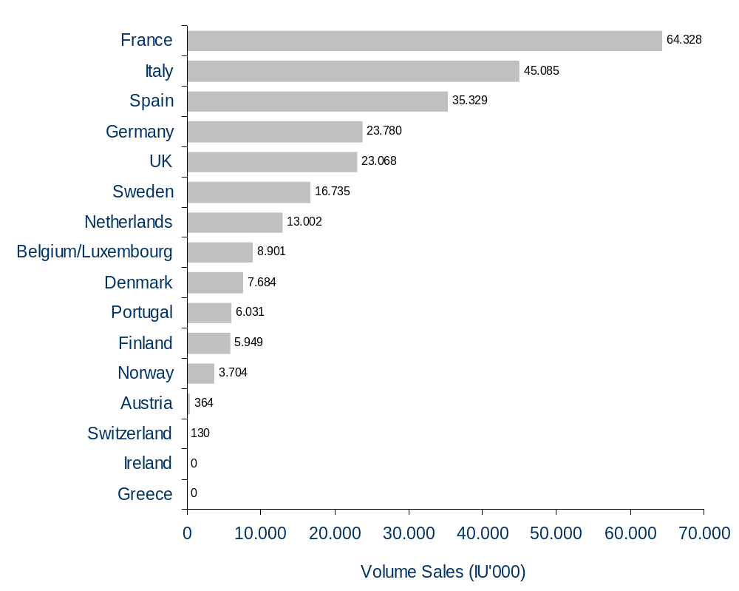
BeneFIX Market MAT Volume Sales Performance
per Country
EI is calculated vs. the Europe 16 BeneFIX Market
Source: IMS MIDAS Data, MAT 07/2012

Slide 10
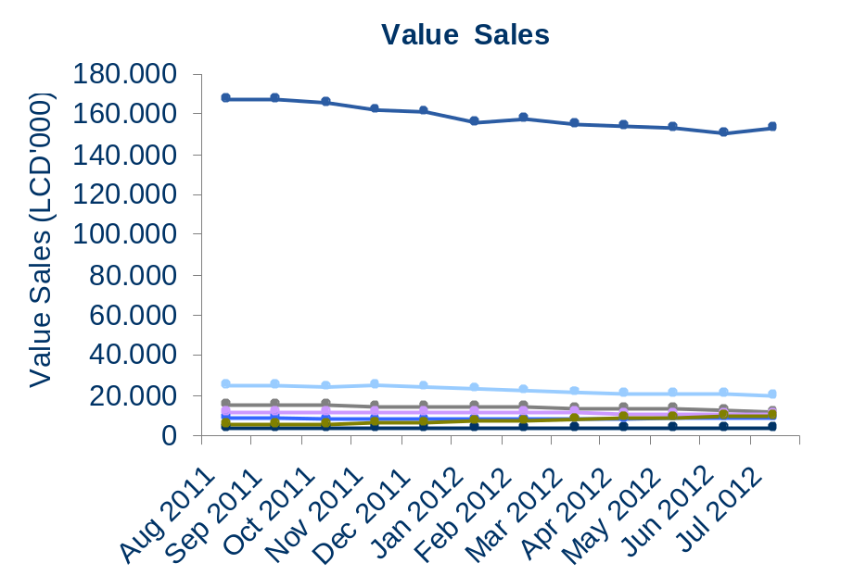
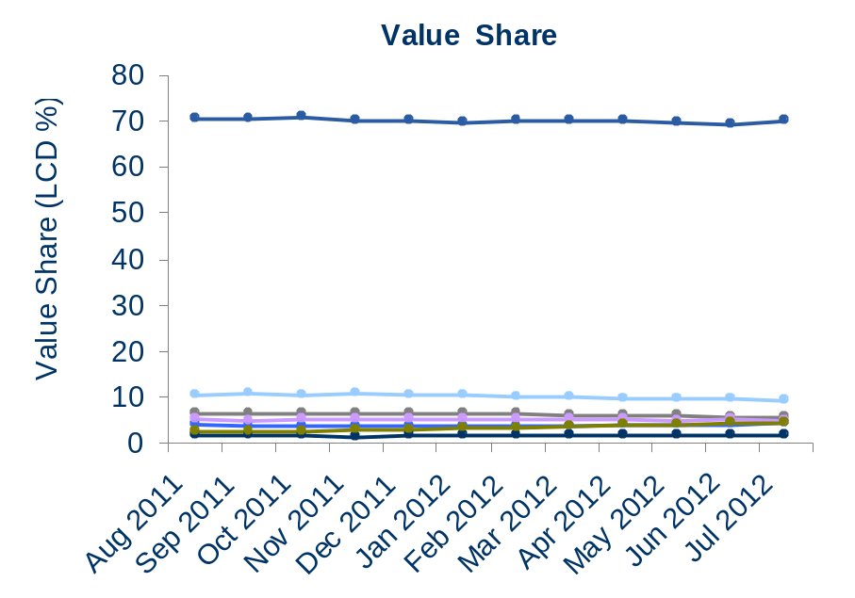
BeneFIX Market
MAT Value Trends
Share is calculated vs. the Europe 16 BeneFIX Market
Source: IMS MIDAS Data, MAT 07/2012

Slide 11
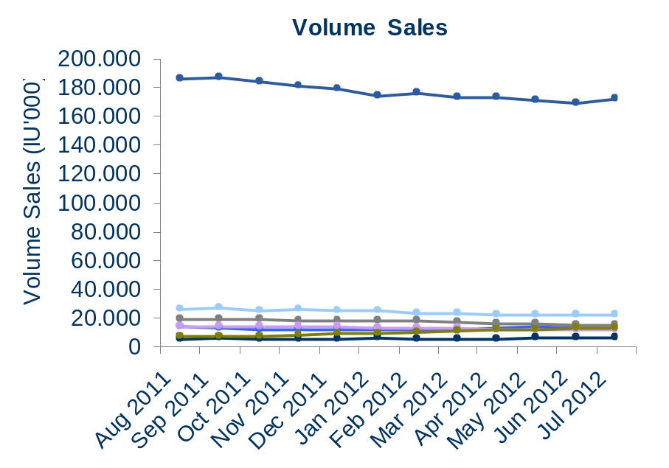
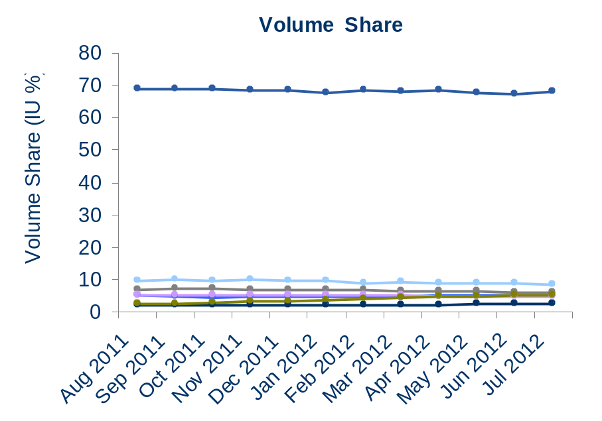
BeneFIX Market
MAT Volume Trends
Share is calculated vs. the Europe 16 BeneFIX Market
Source: IMS MIDAS Data, MAT 07/2012

Slide 12
BeneFIX Performance

Slide 13
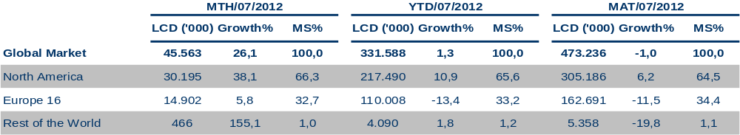
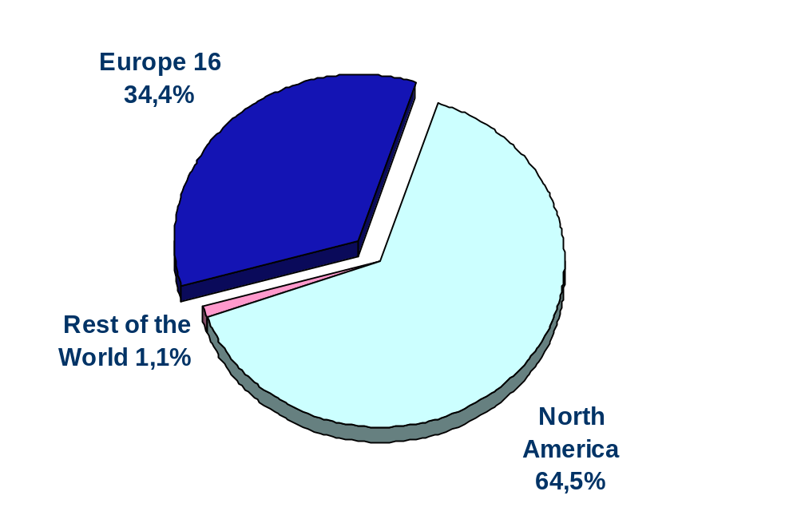
BeneFIX Value Sales Performance
per Region
MAT Sales share
Share is calculated vs. the Global BeneFIX market. Included are all BeneFIX sales in the country panels for North America (Canada, US, Puerto Rico) and for Rest of the World (Australia, Bulgaria, Croatia, Czech Rep, Estonia. Hungary, Latvia, Lithuania, Poland, Romania, Russia, Slovenia, Turkey)
Source: IMS MIDAS Data, MAT 07/2012

Slide 14
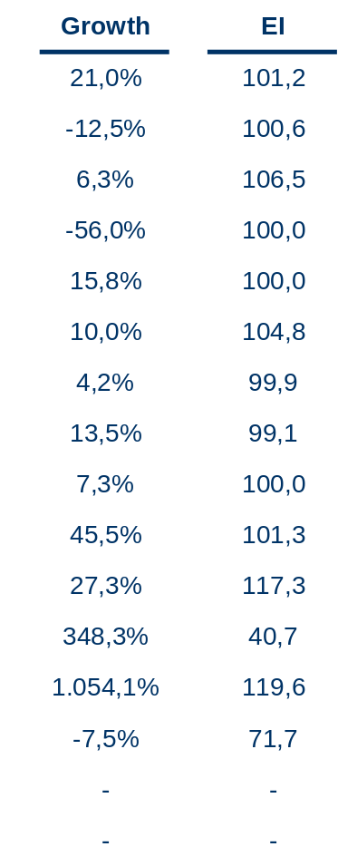
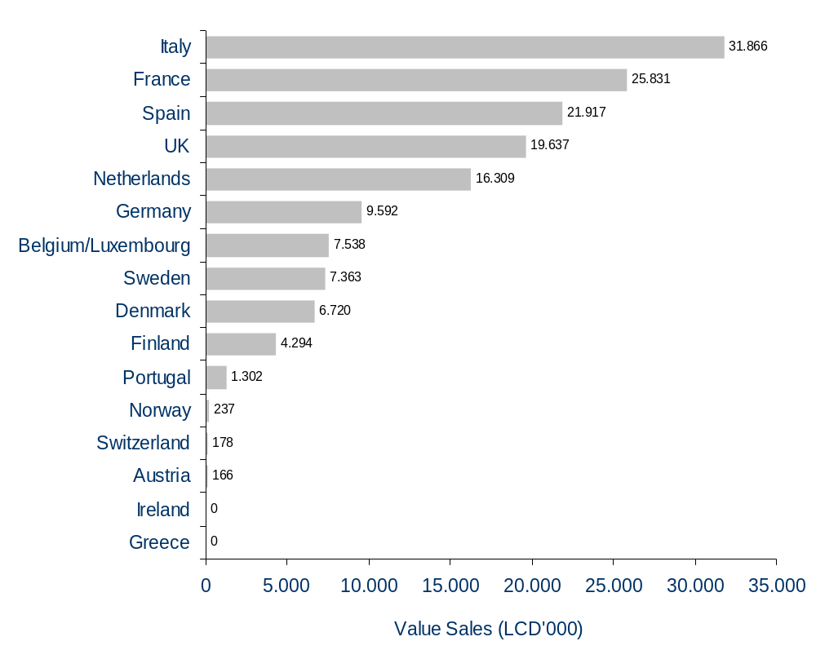
BeneFIX MAT Value Sales Performance
per Country
EI is calculated vs. the Country BeneFIX Market
Source: IMS MIDAS Data, MAT 07/2012

Slide 15
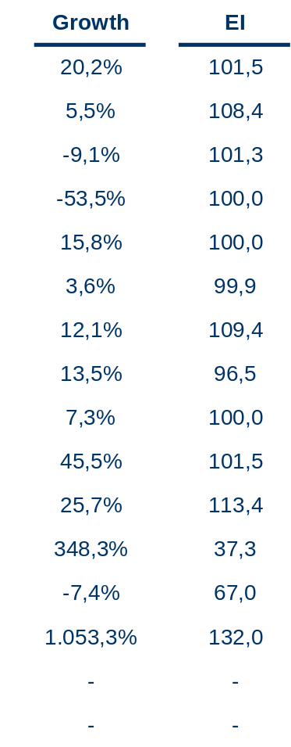
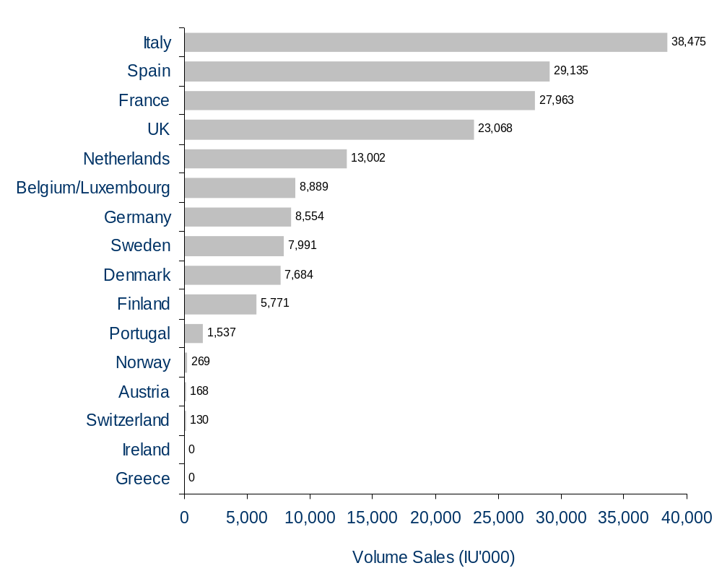
BeneFIX MAT Volume Sales Performance
per Country
EI is calculated vs. the Country BeneFIX Market
Source: IMS MIDAS Data, MAT 07/2012

Slide 16
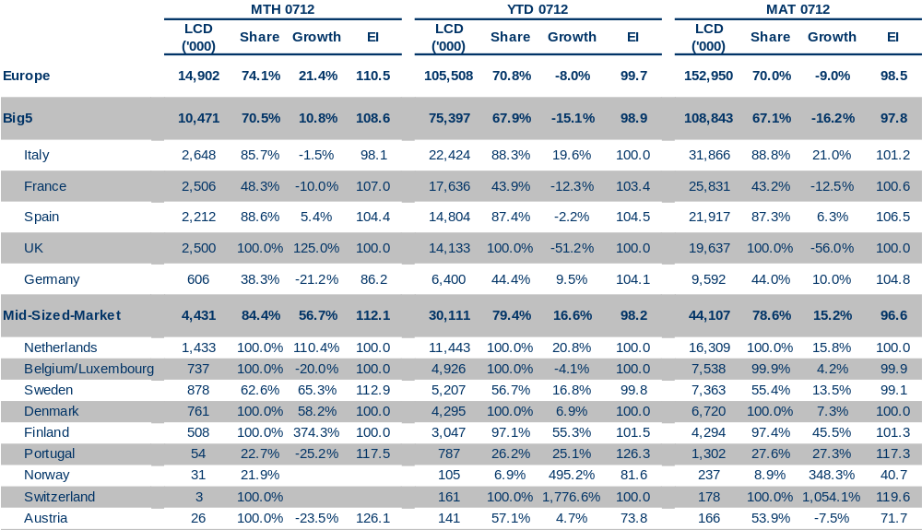
Europe & Country BeneFIX Value Sales
Performance Overview
Share and EI is calculated vs. the Europe 16 BeneFIX market
Source: IMS MIDAS Data, MAT 07/2012

Slide 17
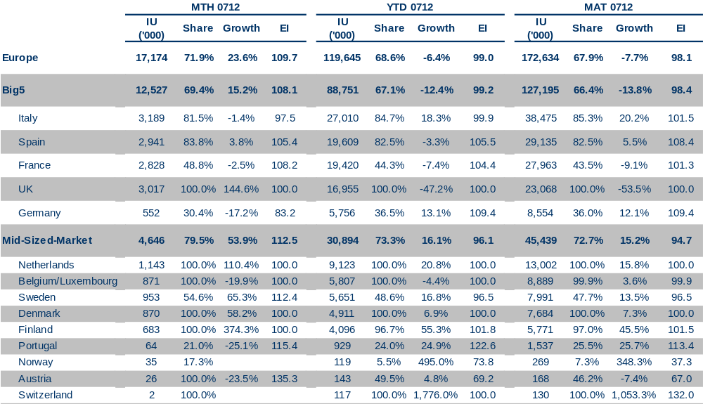
Europe & Country BeneFIX Volume Sales
Performance Overview
Share and EI is calculated vs. the Europe 16 BeneFIX market
Source: IMS MIDAS Data, MAT 07/2012

Slide 18
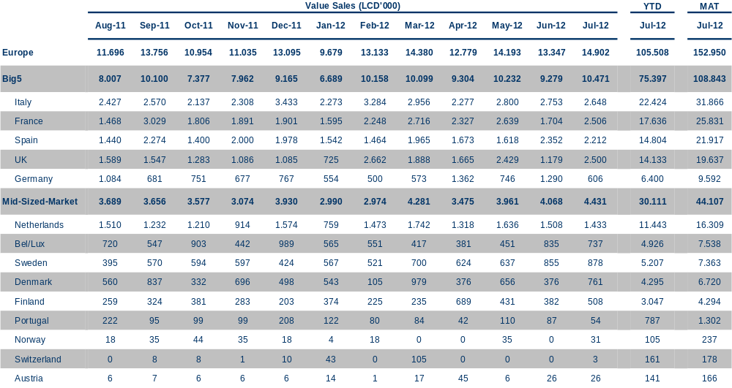
BeneFIX Historic Value Sales
per Region
Source: IMS MIDAS Data, MAT 07/2012

Slide 19
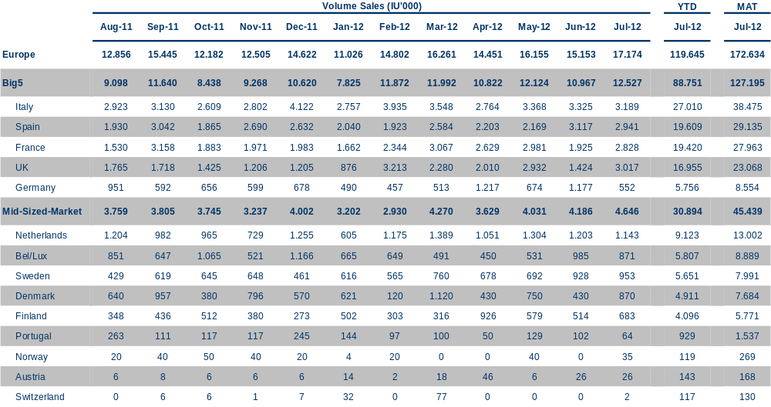
BeneFIX Historic Volume Sales
per Region
Source: IMS MIDAS Data, MAT 07/2012

Slide 20
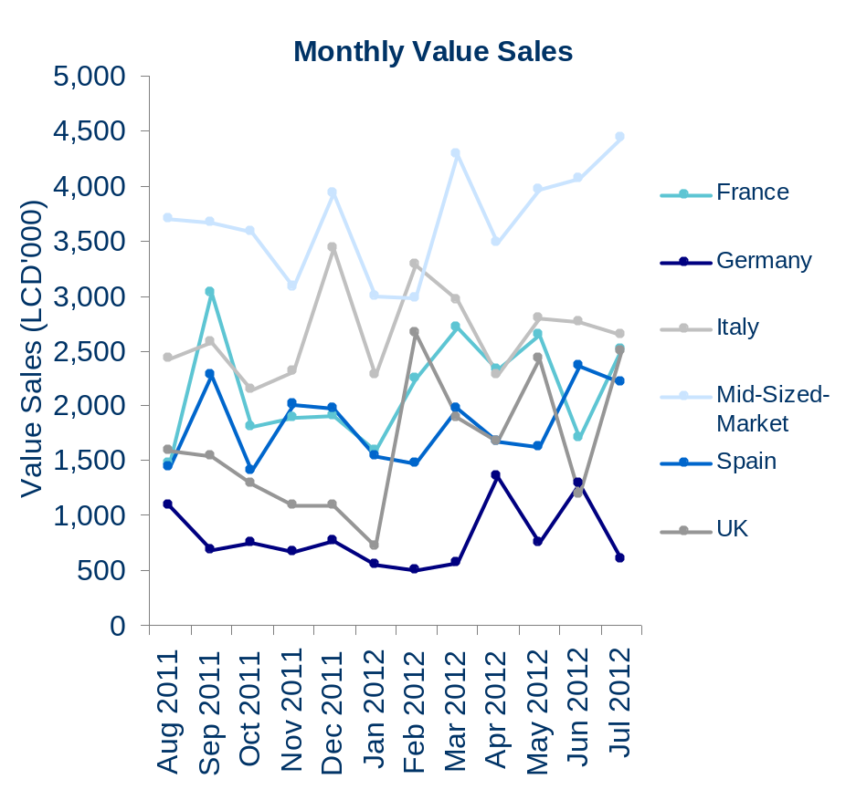
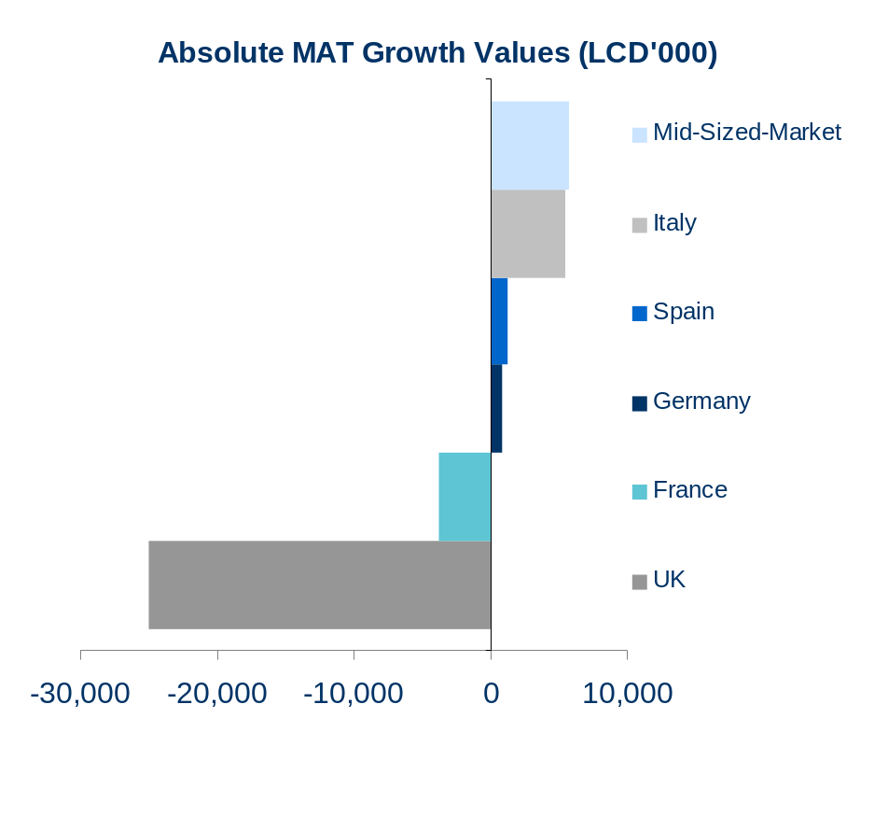
BeneFIX Sales Trends
by Country
Source: IMS MIDAS Data, MAT 07/2012

Slide 21
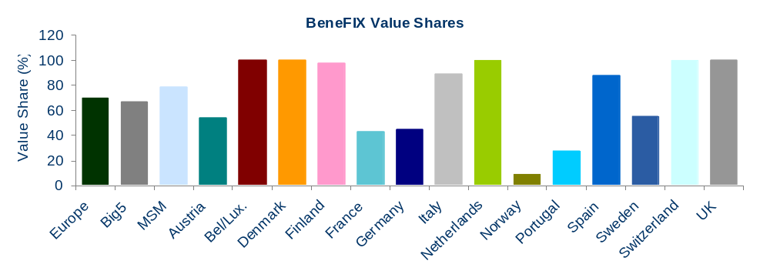
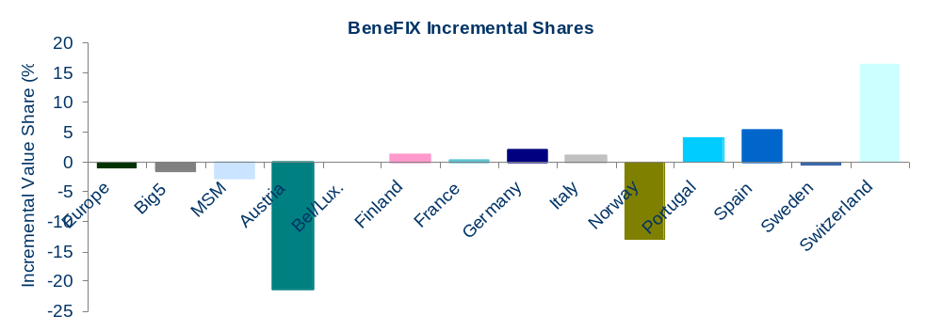
BeneFIX MAT Sales Shares
By Country
Share is calculated vs. the Country BeneFIX market
Source: IMS MIDAS Data, MAT 07/2012

Slide 22
Country Performances

Slide 23

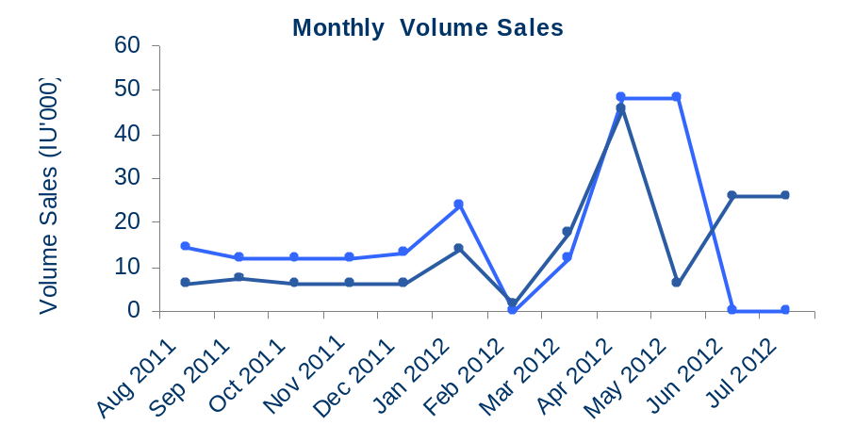
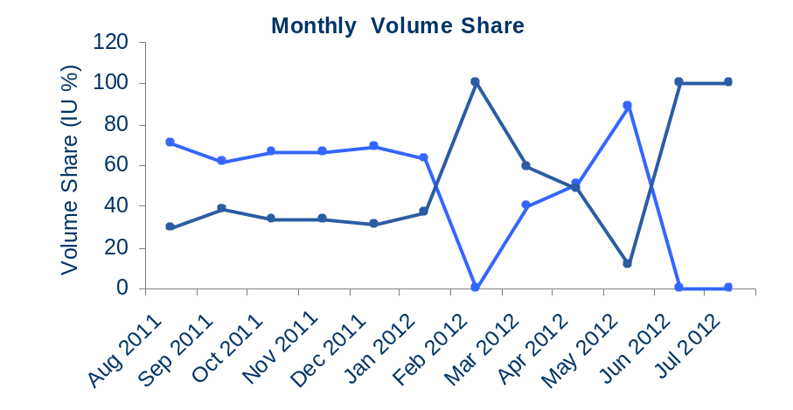
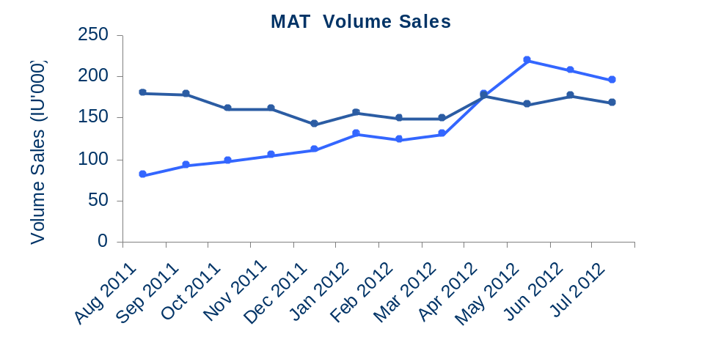
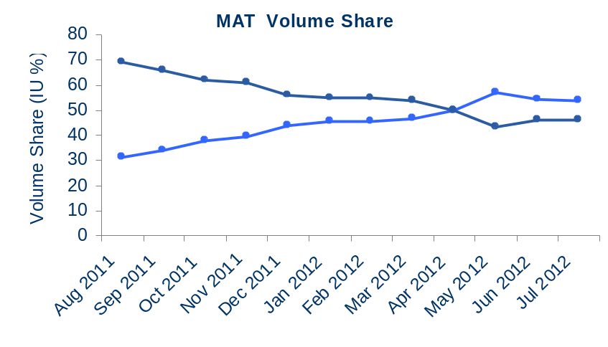
Austria BeneFIX Market Overview
Shares are calculated vs. the Country BeneFIX Market
Source: IMS MIDAS Data, MAT 07/2012

Slide 24

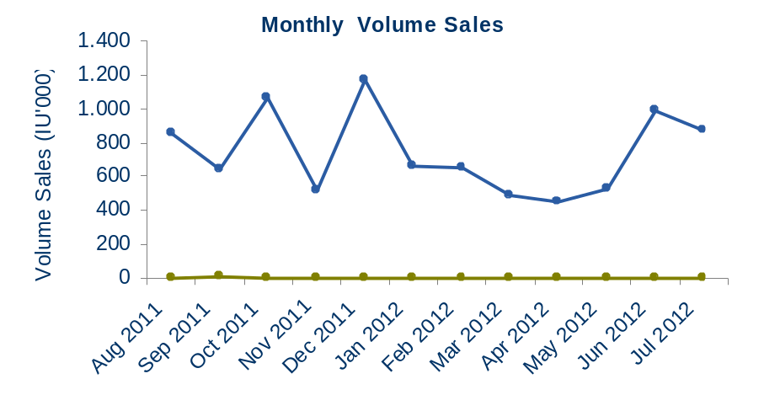
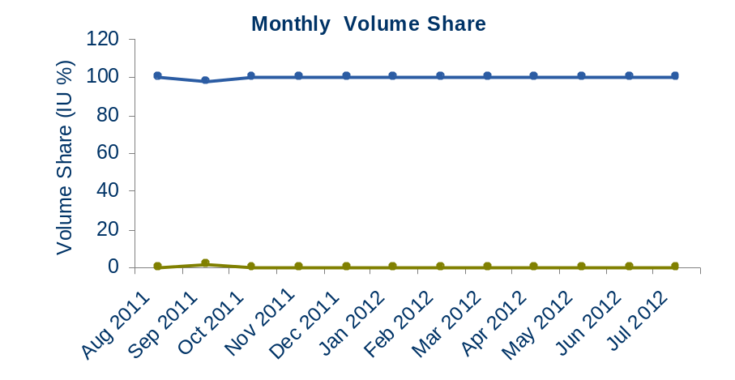
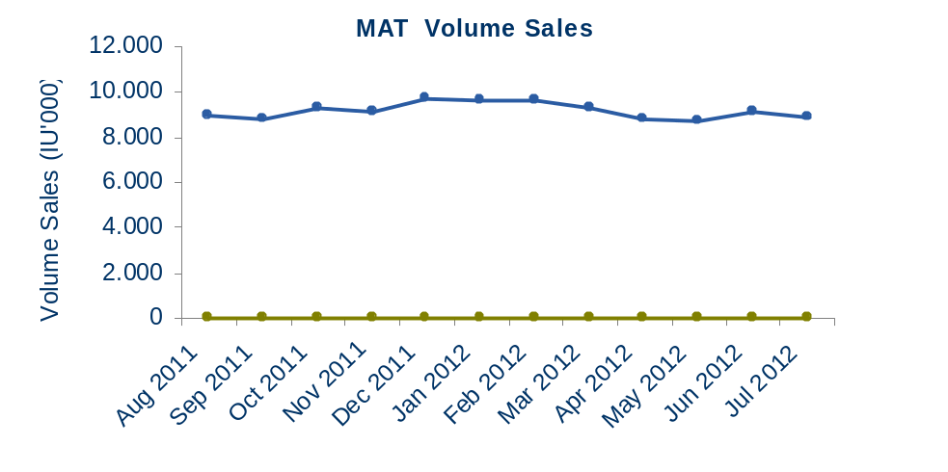
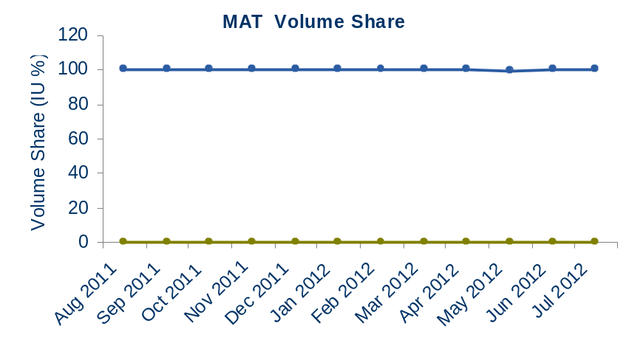
Belgium/Luxemb. BeneFIX Market Overview
Shares are calculated vs. the Country BeneFIX Market
Source: IMS MIDAS Data, MAT 07/2012

Slide 25

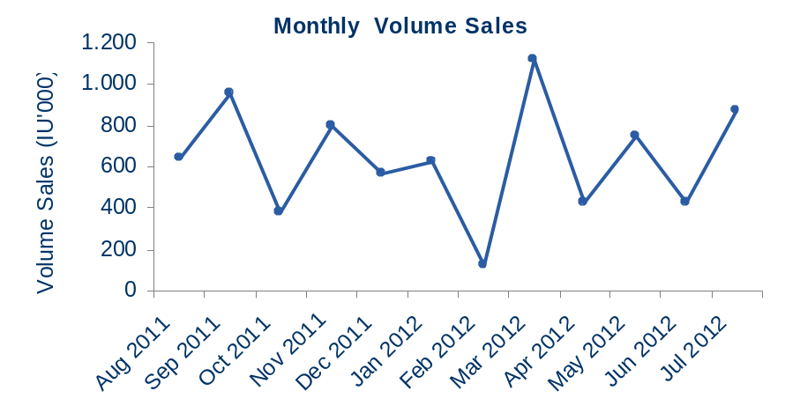
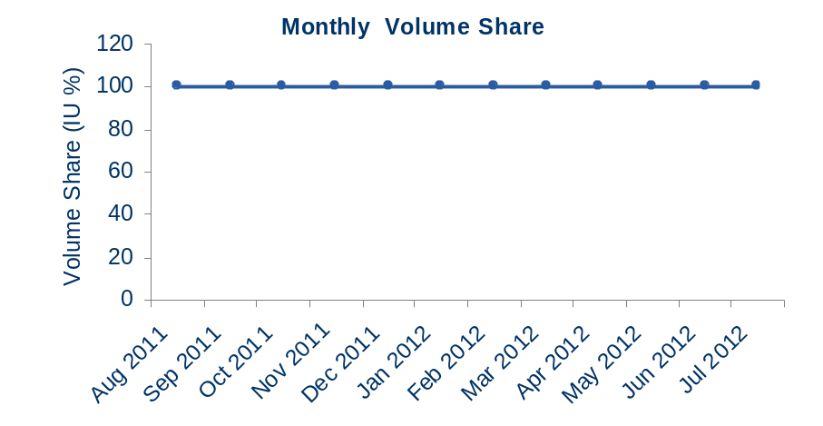
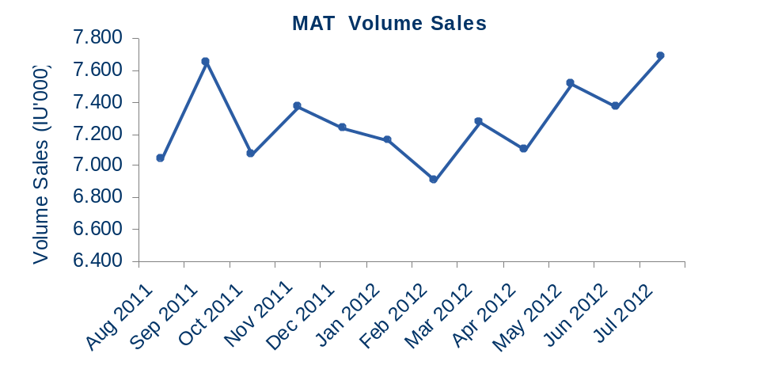
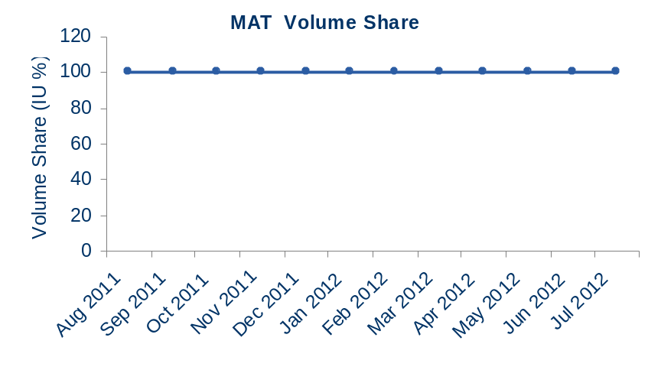
Denmark BeneFIX Market Overview
Shares are calculated vs. the Country BeneFIX Market
Source: IMS MIDAS Data, MAT 07/2012

Slide 26

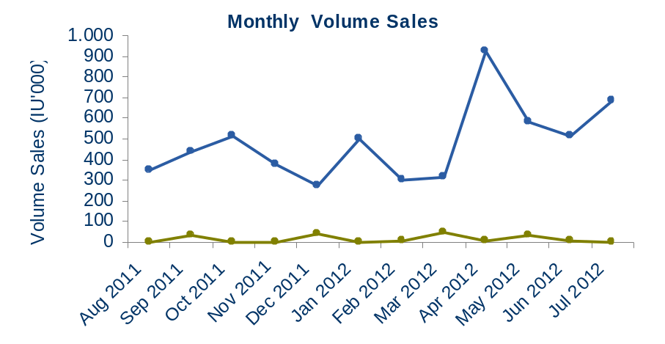
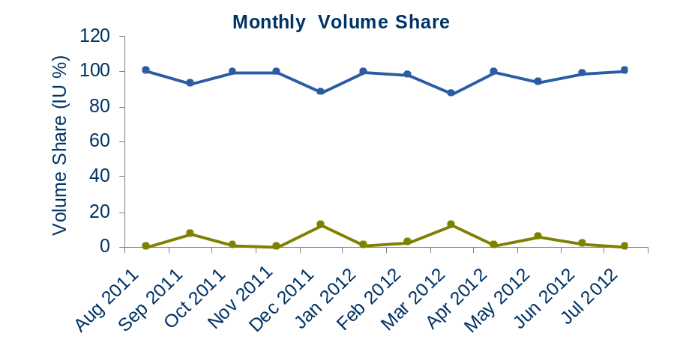
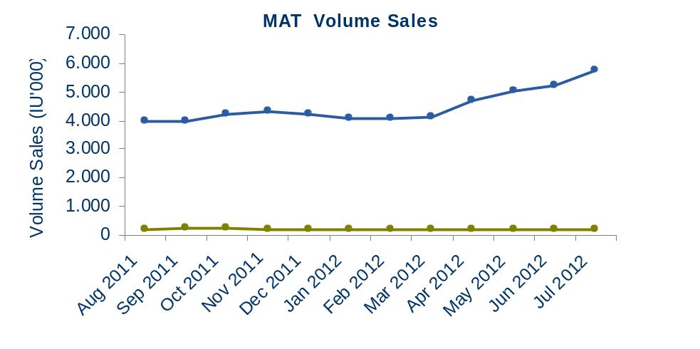
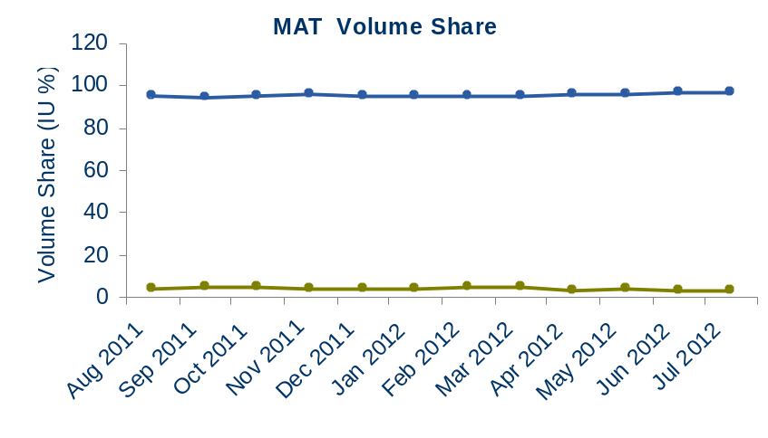
Finland BeneFIX Market Overview
Shares are calculated vs. the Country BeneFIX Market
Source: IMS MIDAS Data, MAT 07/2012

Slide 27

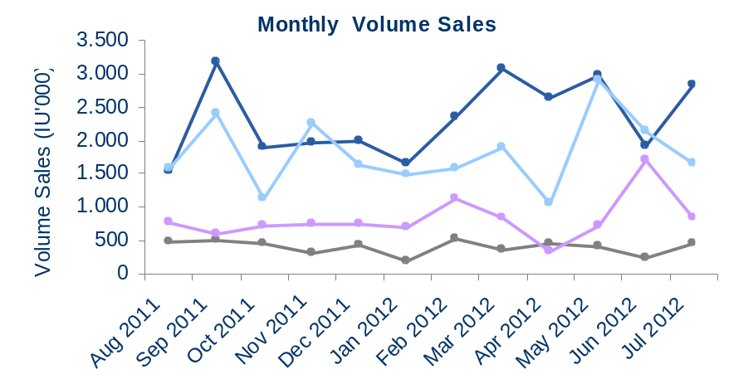
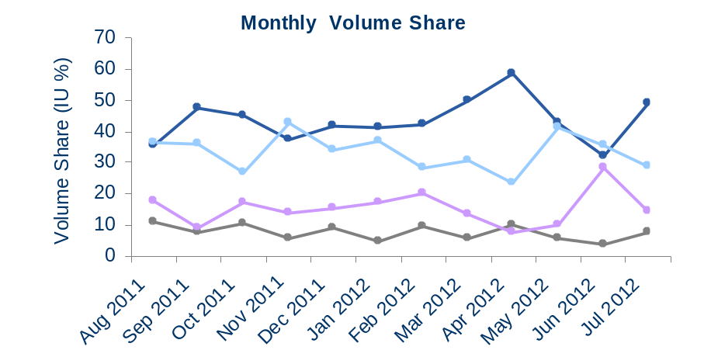
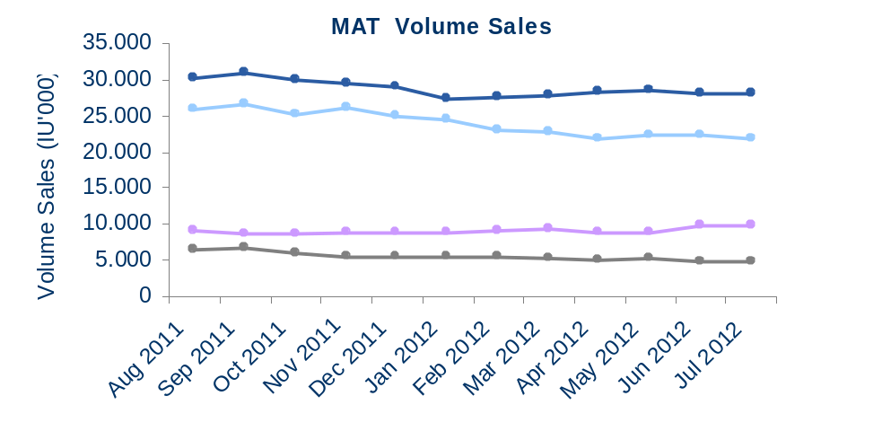
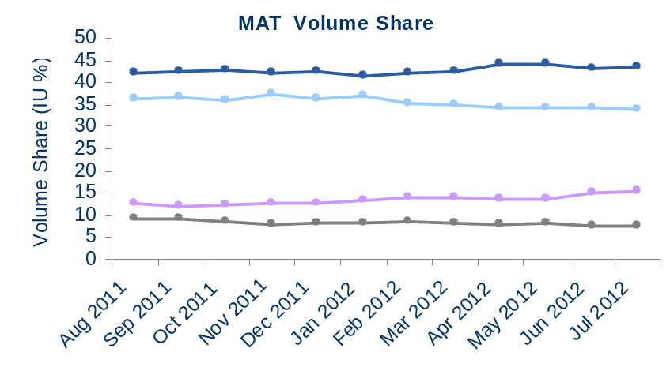
France BeneFIX Market Overview
Shares are calculated vs. the Country BeneFIX Market
Source: IMS MIDAS Data, MAT 07/2012

Slide 28

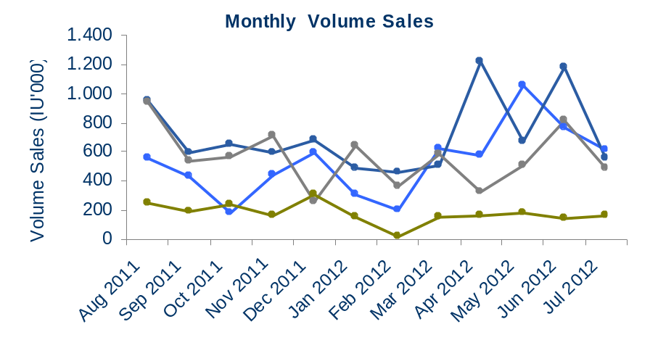
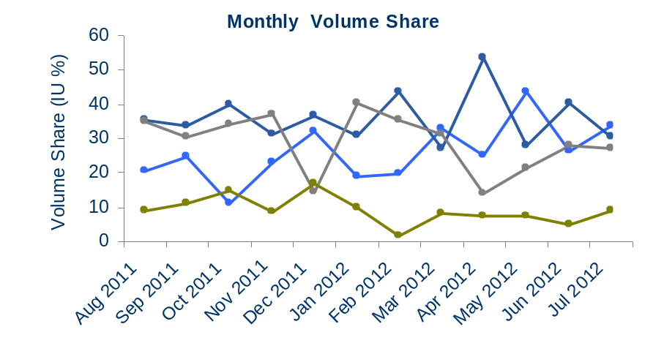
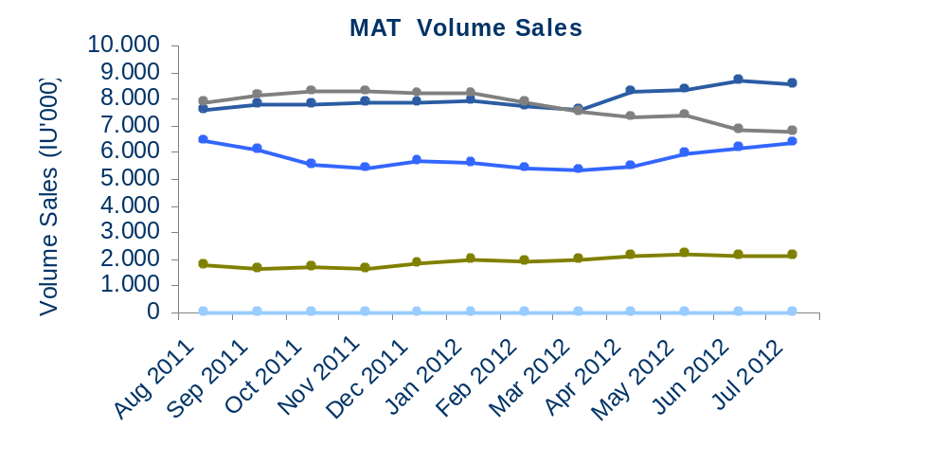
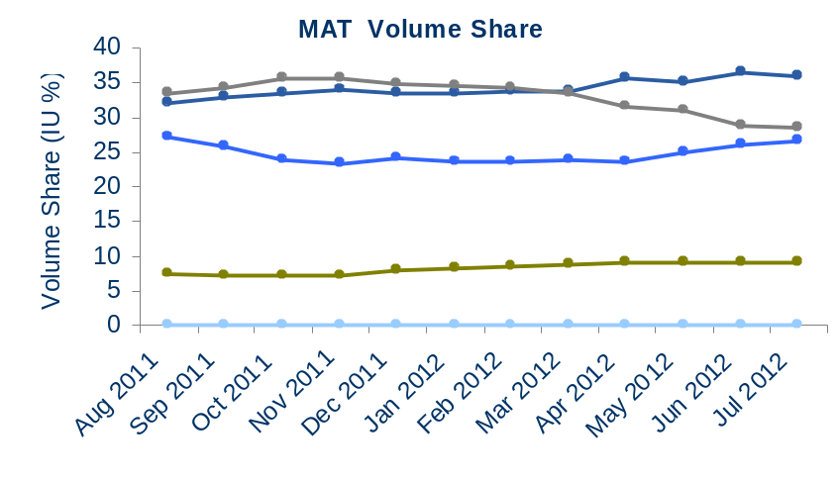
Germany BeneFIX Market Overview
Shares are calculated vs. the Country BeneFIX Market
Source: IMS MIDAS Data, MAT 07/2012

Slide 29



Greece BeneFIX Market Overview
Shares are calculated vs. the Country BeneFIX Market
Source: IMS MIDAS Data, MAT 07/2012

Slide 30





Italy BeneFIX Market Overview
Shares are calculated vs. the Country BeneFIX Market
Source: IMS MIDAS Data, MAT 07/2012

Slide 31



Netherlands BeneFIX Market Overview
Shares are calculated vs. the Country BeneFIX Market
Source: IMS MIDAS Data, MAT 07/2012

Slide 32





Norway BeneFIX Market Overview
Shares are calculated vs. the Country BeneFIX Market
Source: IMS MIDAS Data, MAT 07/2012

Slide 33





Portugal BeneFIX Market Overview
Shares are calculated vs. the Country BeneFIX Market
Source: IMS MIDAS Data, MAT 07/2012

Slide 34





Spain BeneFIX Market Overview
Shares are calculated vs. the Country BeneFIX Market
Source: IMS MIDAS Data, MAT 07/2012

Slide 35





Sweden BeneFIX Market Overview
Shares are calculated vs. the Country BeneFIX Market
Source: IMS MIDAS Data, MAT 07/2012

Slide 36





Switzerland BeneFIX Market Overview
Shares are calculated vs. the Country BeneFIX Market
Source: IMS MIDAS Data, MAT 07/2012

Slide 37



UK BeneFIX Market Overview
Shares are calculated vs. the Country BeneFIX Market
Source: IMS MIDAS Data, MAT 07/2012

Slide 38
Definitions
MARKET DEFINITION
  Haemophilia Franchise: BENEFIX + REFACTO
  BeneFIX Market: BENEFIX, BETAFACT, MONONINE, NANOTIV, BEBULIN, AIMAFIX DI, OCTANINE F
DATA SOURCES
  Monthly IMS MIDAS Database
  Retail & Hospital Data
MEASURES
  Value Sales in LCD (Local Currency Dollar)
  Volume Sales in IU (International Units)
FORMULA
  EI = [(Product or Country Growth + 100) / (Market Growth + 100)] * 100
  IU = SU * IU Dosage
GEOGRAPHY
  EUROPE 16
    BIG 5: France, Germany, Italy, Spain, UK
    MID-SIZED-MARKETS: Austria, Belgium/Luxembourg, Denmark, Finland, Greece, Ireland, Netherlands, Norway, Portugal, Sweden, Switzerland

Slide 39

Included Panels
Audit Types: Retail: Sell-In (SI) / Sell-Out (SO), Hospital: Wholesaler (W) / Consumption (C)
Source: IMS MIDAS Data, MAT 07/2012

